Slide 1

Data Mining – Meeting 5
Roi Yehoshua
Partially based on slides of Noam Koenigstein
The Open University

Slide 2
Agenda
Bayesian Classification
Bayesian Belief Networks
Instance-Based Classification Methods (Unit 7)

Slide 3
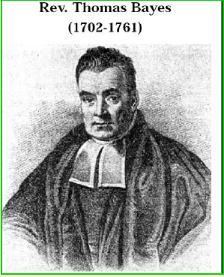
Bayesian Classification
Basic Assumption: The observed data is governed by probability distributions
Using prior knowledge on probability distributions we can predict the classification of a new sample
Using Bayes Rule
Algorithms:
Naïve Bayes Classifier
Bayesian Belief Networks

Slide 4
Practical Problems
Typically require initial knowledge of many probabilities.
In general many attributes make it impossible to determine the required probabilities
Can be estimated by:
Background knowledge
Previously available data
Assumptions about distribution

Slide 5
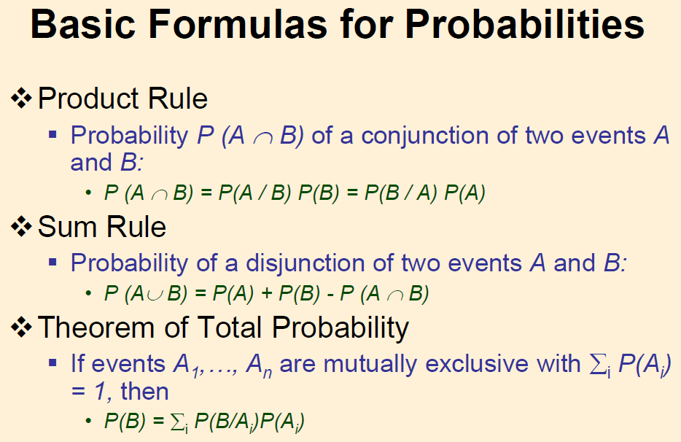

Slide 6
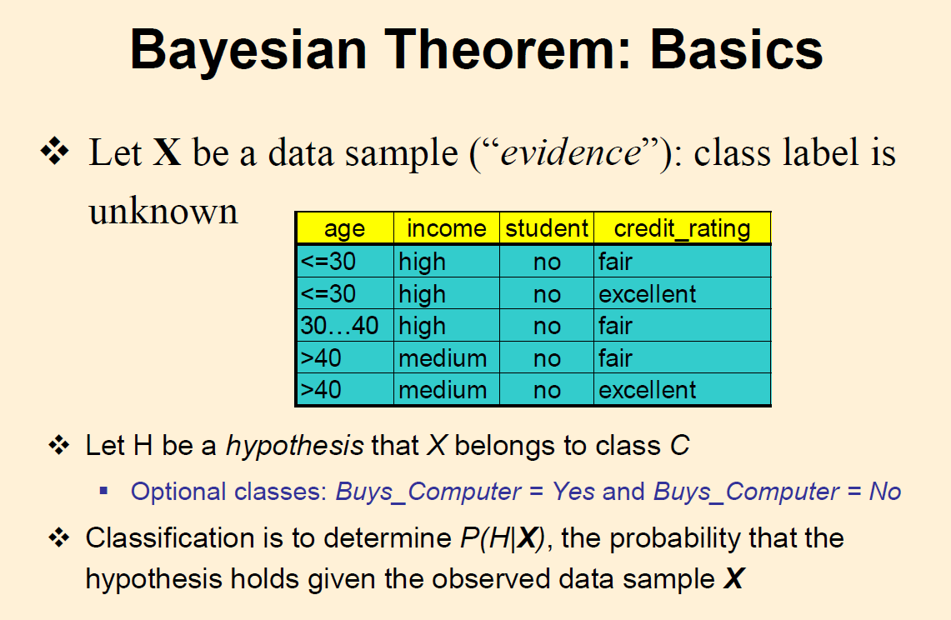

Slide 7
Bayesian Theorem - Basics
P(H) (Prior probability) – the initial probability
e.g., X will buy a computer, regardless of age, income, etc.
P(X) – The probability that the data is observed
e.g., that X is in the age 31..40, low income, etc.
P(H|X) (Posterior probability) – The probability of hypothesis H given that sample X was observed
e.g., given X, the probability that he/she will buy a computer

Slide 8
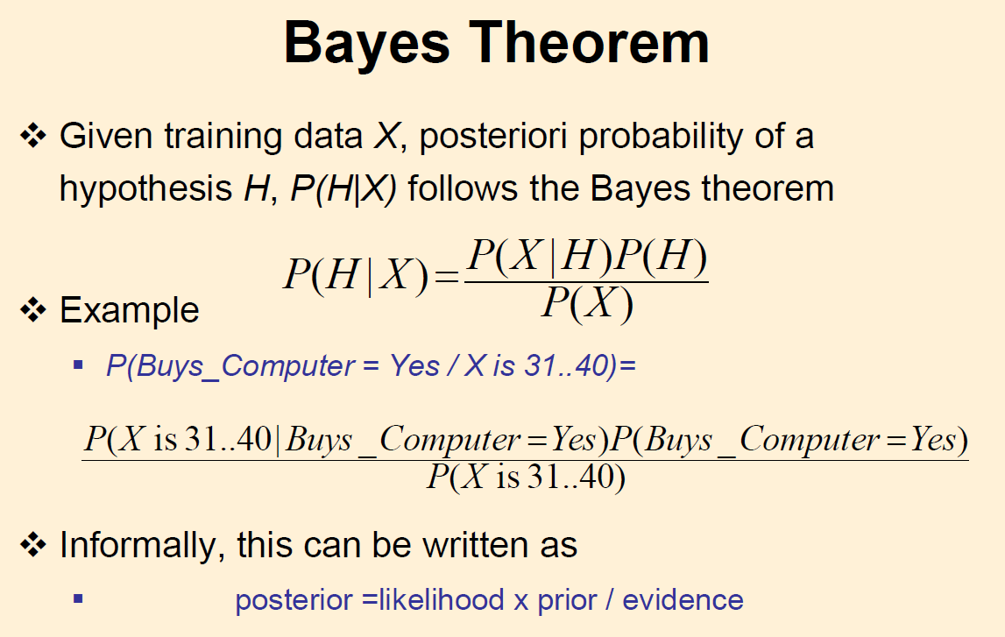

Slide 9
MAP - Maximum A Posteriori Hypothesis
Many learning algorithms try to identify the most probable hypothesis h ∈ H given observations D
This is the maximum a posteriori hypothesis (MAP hypothesis)

Slide 10
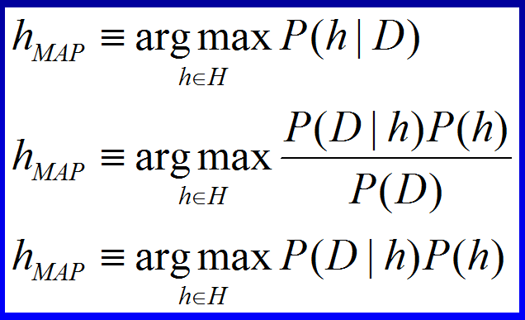
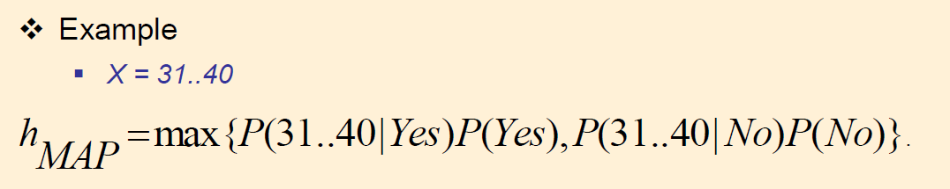
MAP Cont.

Slide 11
Bayesian Theorem Example Does patient have cancer or not?
A patient takes a lab test and the result comes back positive.
It is known that when a patient is sick, the test returns a correct positive result in only 98% of the cases
When the patient is healthy it returns a correct negative result in only 97% of the cases.
Furthermore, only 0.008 of the entire population has this disease.
1. What is the probability that this patient has cancer?
2. What is the probability that he does not have cancer?
3. What is the diagnosis?

Slide 12
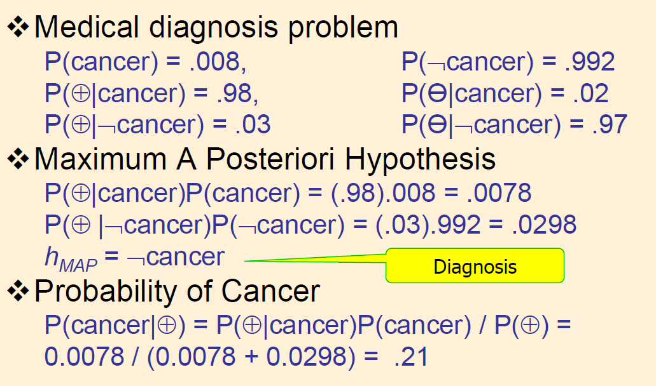
Bayesian Theorem Example Does patient have cancer or not?

Slide 13
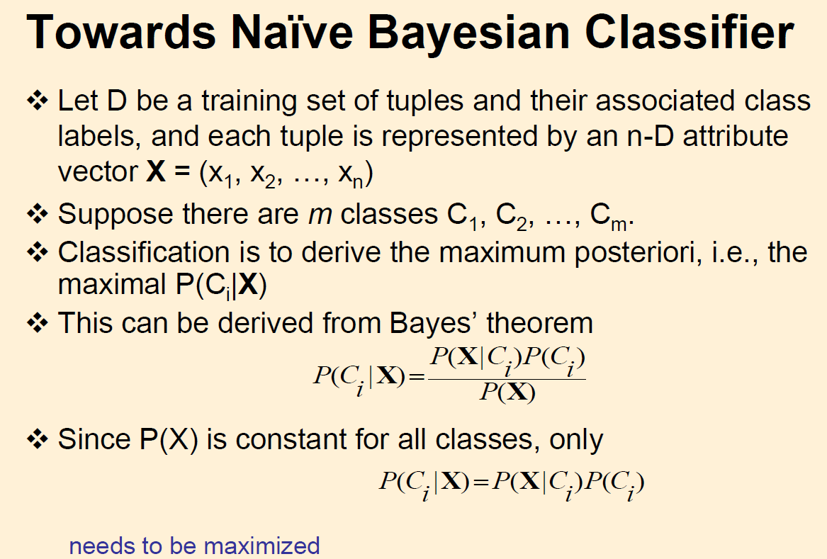

Slide 14
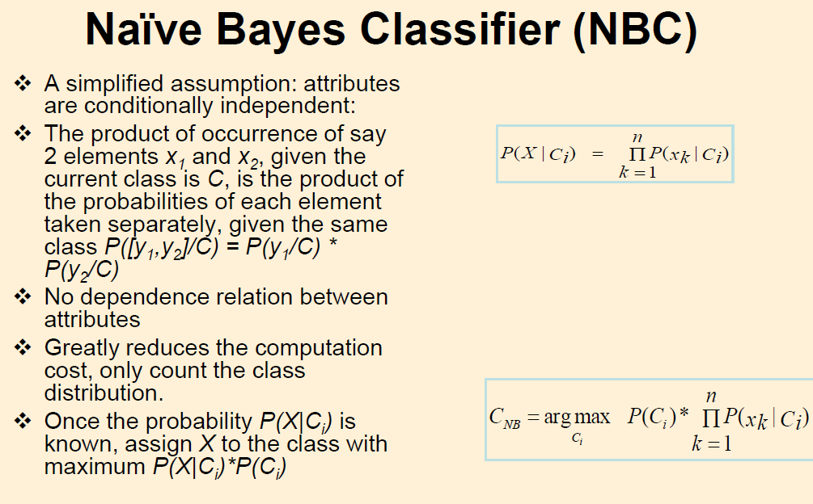

Slide 15
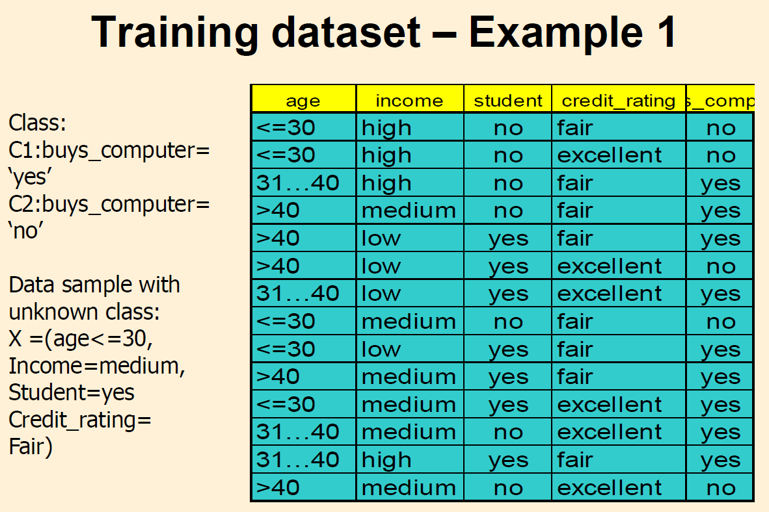

Slide 16
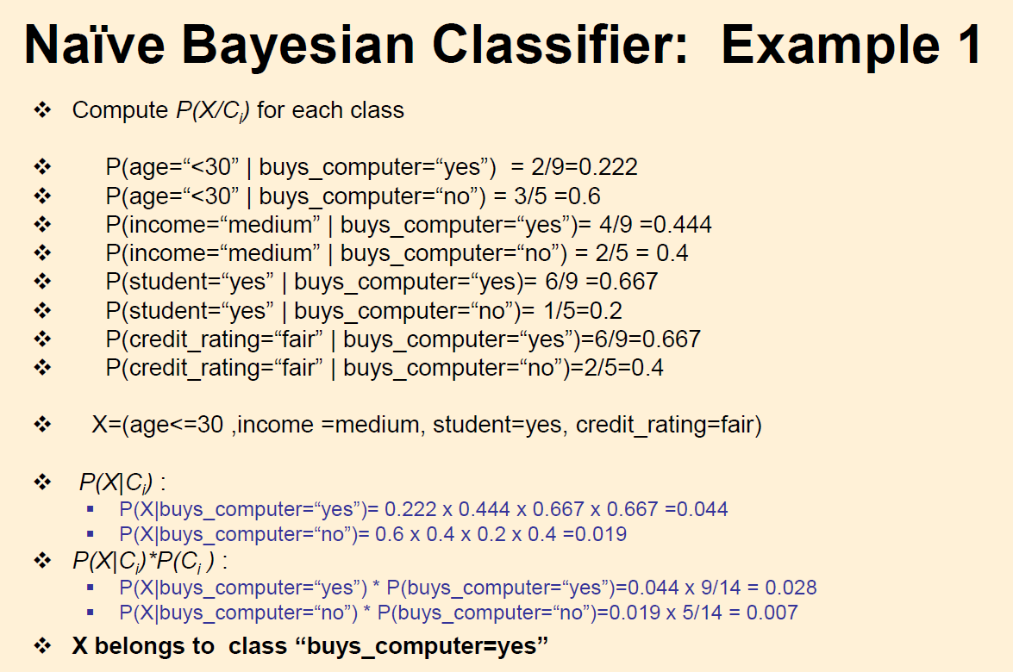

Slide 17
Laplacian Correction
What is there are no training tuples for a given variable condition
In other words, what happens if there is a 0 probability for some P(X_{k}|H)?
A zero probability cancels the effects of all the other (posteriori) probabilities involved in the product

Slide 18
Laplacian Correction
There is a simple trick to avoid this problem
We can assume that our training database D is so large that adding one to each count that we need would only make a negligible difference in the estimated probability

Slide 19
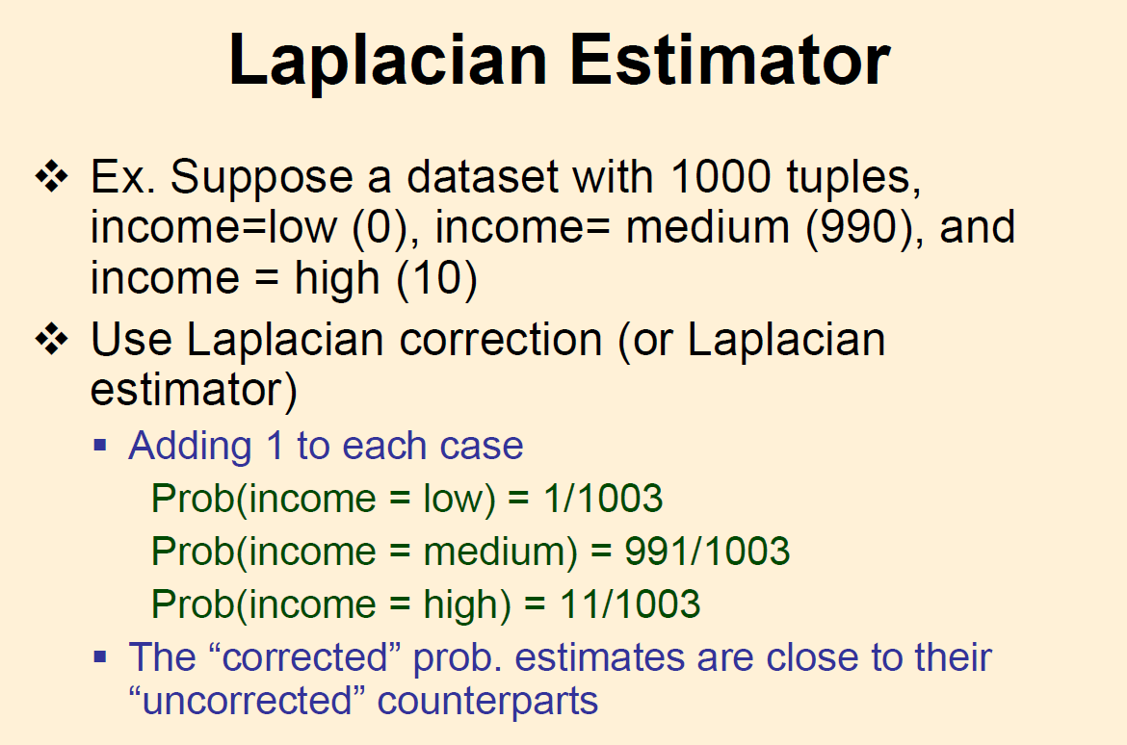

Slide 20
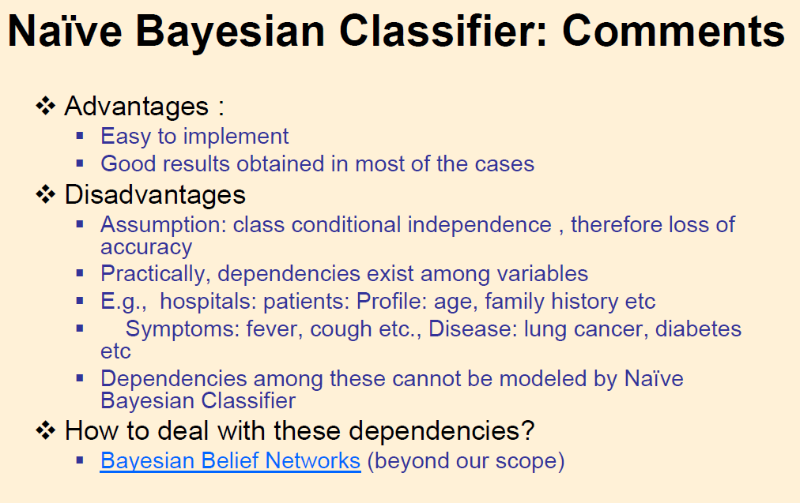

Slide 21
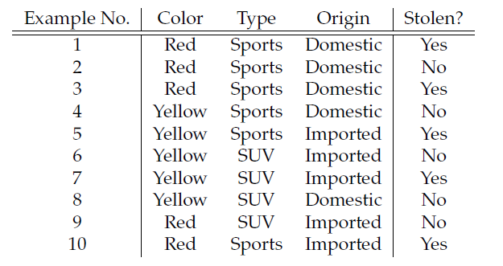
Car Theft Exercise
Classify:

Slide 22
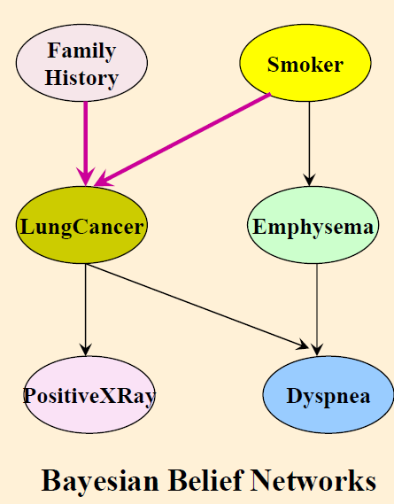

Slide 23
Bayesian Belief Networks
A Bayesian belief network is a probabilistic graphical model that represents a set of random variables and their conditional dependencies via a directed acyclic graph (DAG)
For example, a Bayesian network could represent the probabilistic relationships between diseases and symptoms.
Given symptoms, the network can be used to compute the probabilities of the presence of various diseases.
Using a Bayesian network can save considerable amounts of memory, if the dependencies in the joint distribution are sparse.

Slide 24
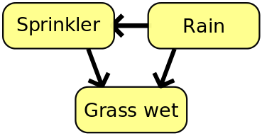
Bayesiean Network Example
Rain influences whether the sprinkler is activated, and both rain and the sprinkler influence whether the grass is wet.

Slide 25
Bayesian Belief Networks
Each node is associated with a probability function that takes as input a particular set of values for the node's parent variables and gives the probability of the variable represented by the node
For example, if the parents are Boolean variables then the probability function could be represented by a table of entries, one entry for each of the possible combinations of its parents being true or false

Slide 26
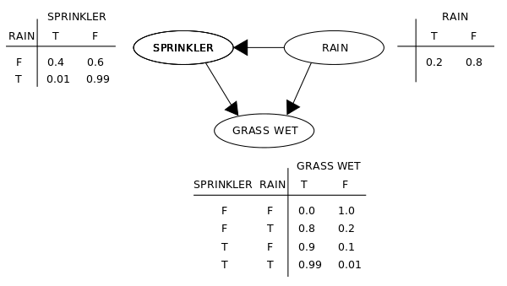
Bayesian Belief Networks

Slide 27

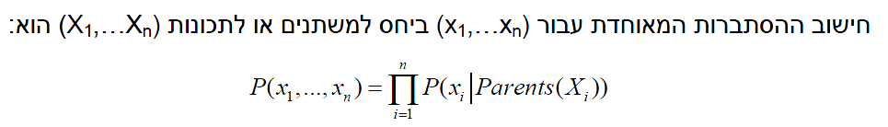
Bayesian Belief Networks
The joint probability function is:
G = Grass wet (yes/no)
S = Sprinkler turned on (yes/no)
R = Raining (yes/no)

Slide 28
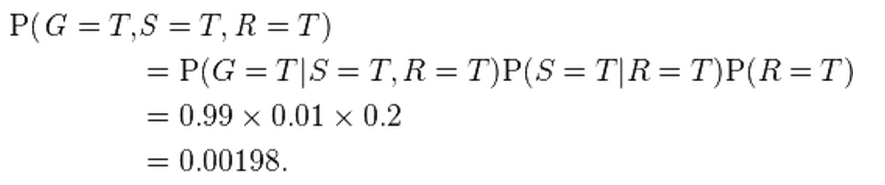
Bayesian Belief Networks
What is the probability that it is raining, given the grass is wet?
Using the expansion for the joint probability function and the conditional probabilities stated in the diagram, one can evaluate each term in the sums in the numerator and denominator. For example,

Slide 29
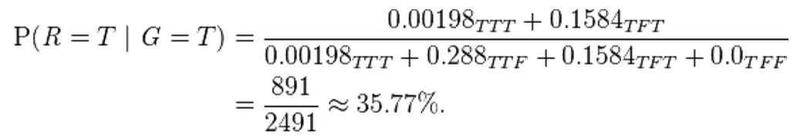
Bayesian Belief Networks
Then the numerical results (subscripted by the associated variable values) are

Slide 30
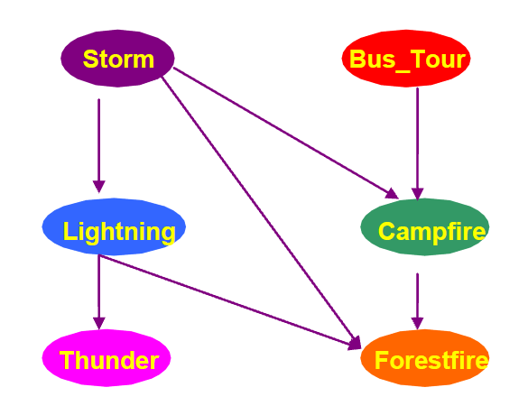
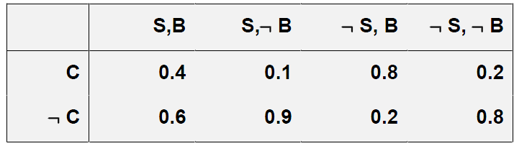
Example:
CPT Campfire:

Slide 31
Example:
Getting probabilities

Slide 32

Example:

Slide 33
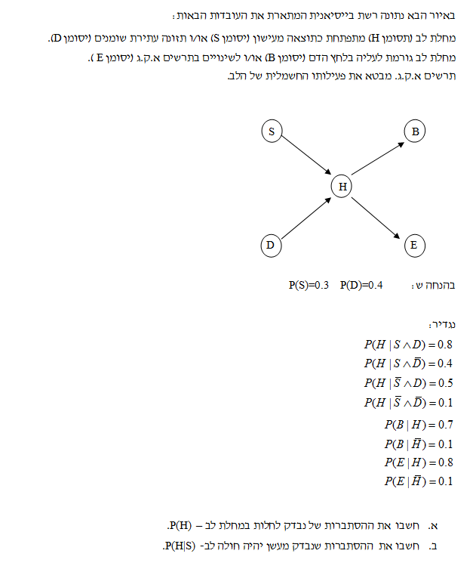
תרגיל

Slide 34
Instance-Based Classification Methods
Model-based (“eager” learning)
Process training examples and store the modelfor classification of future instances
Instance-based (memory-based) learning
Store training examples and delay the processing (“lazy evaluation”) until a new instance must be classified
Typical approaches of instance-based learning
k-nearest neighbor approach
Instances represented as points in a Euclidean space.
Kernel methods / Locally weighted regression
Construct local approximation
Case-based reasoning
Uses symbolic representations and knowledge-based inference

Slide 35
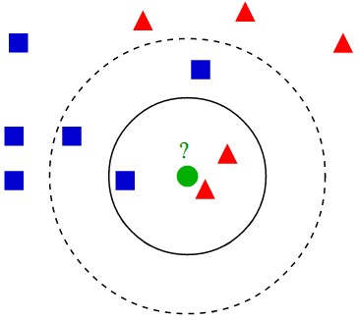
k-NN Classifier
All instances correspond to points in the n-D space X=(x₁,x₂,x₃,….,x_{n})
the k-NN returns the most common value among the k training examples nearest to x_{q}.

Slide 36
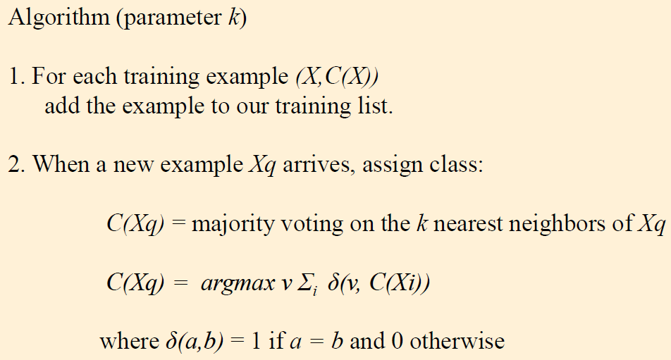
k-NN Classifier

Slide 37
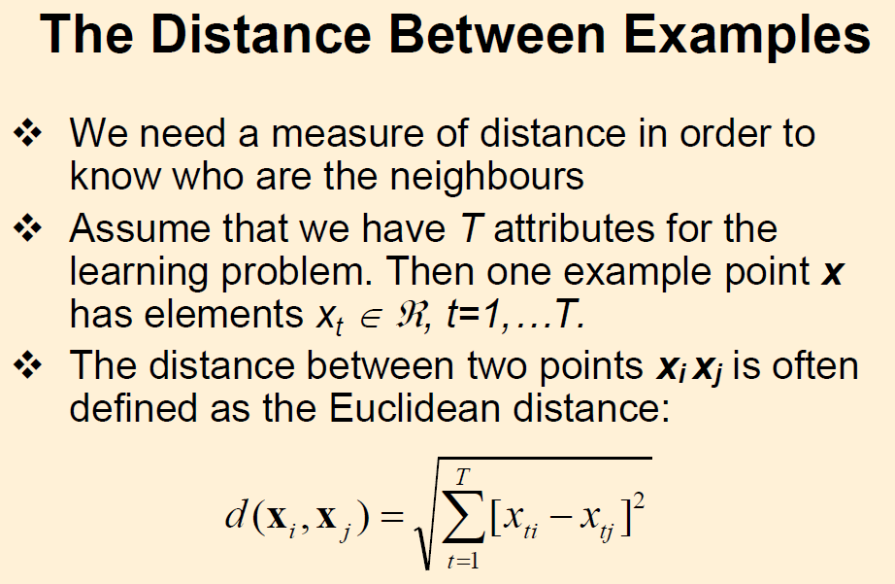

Slide 38

Question ?
But what happens when the different attributes are on different scale?
Attributes need normalization!!

Slide 39
But what about distance for attributes that are not numeric?
Answer: We need some way to translate agreement/ disagreement into distance measurement
If the values agree => distance is 0 If the values disagree => distance is 1

Slide 40
What about missing values?
In general if an attribute’s value is on one of the tuples is missing, we assume the maximum possible distance.
For categorical attributes we take a distance of 1 if one or both of the values are missing (in the two tuples)
If a numerical value is missing from both tuples we again take 1 as the distance in that dimension.
If only one value is missing, than the maximum distance is calculated according to:

Slide 41
How do I choose a value of k?
Experimentally determine k based on the test/validation dataset.
In general as the number of training tuples increase, so does the optimal value of k
When the number of training tuples approaches infinity, for k=1, the error rate is not worse than twice the Bayes error rate
Bayes error rate is the theoretical minimum achieved when we predict y that maximizes P(y|x) according to the attributes vector x
When the number of training tuples and k approach infinity, the error rate approaches the Bayes error rate
Notes:
Bayse error rate is the theoretical minimum achieve when we predict y that maximizes P(y|x) according to the attributes vector x
(and a Gaussian noise)

Slide 42
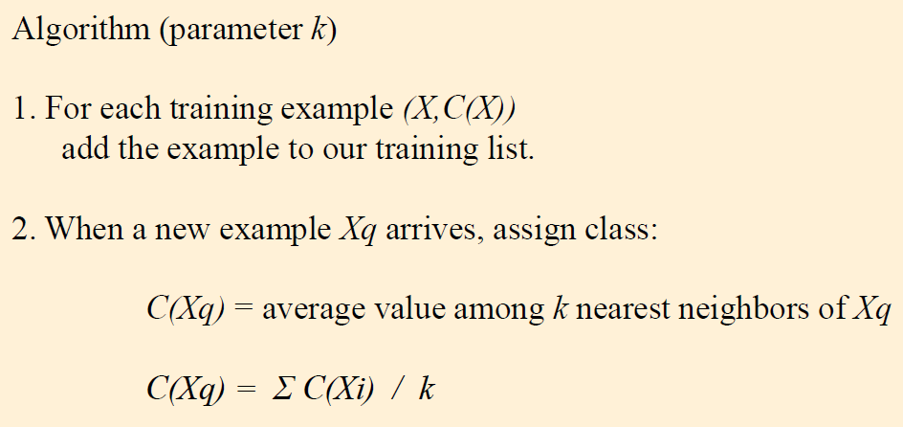
k-NN for real valued functions
And what about numeric prediction???

Slide 43
k-NN last remarks
Advantages
Training is very fast
Learn complex target functions
Don’t lose information
Disadavntages
Slow at query time
Limited interpretability
Curse of dimensionality
Distance between neighbors could be dominated by irrelevant attributes

